Slide 1

Operating System Linux – Day 1.

Slide 2
Day 1. Agenda
What does an operating system do
Practical stuff
Connect with Linux
Create users
Log in
Copy files up / down
Move files around (mv and cp)
Create catalogs
Rights (root, admin, user - rwx - sudo)
Standard in and out, piping, grep

Slide 3

Introduction

Slide 4
What is an Operating System?
A program that acts as an intermediary between a user of a computer and the computer hardware.
Operating system goals:
Execute user programs and make solving user problems easier.
Make the computer system convenient to use.
Use the computer hardware in an efficient manner.

Slide 5
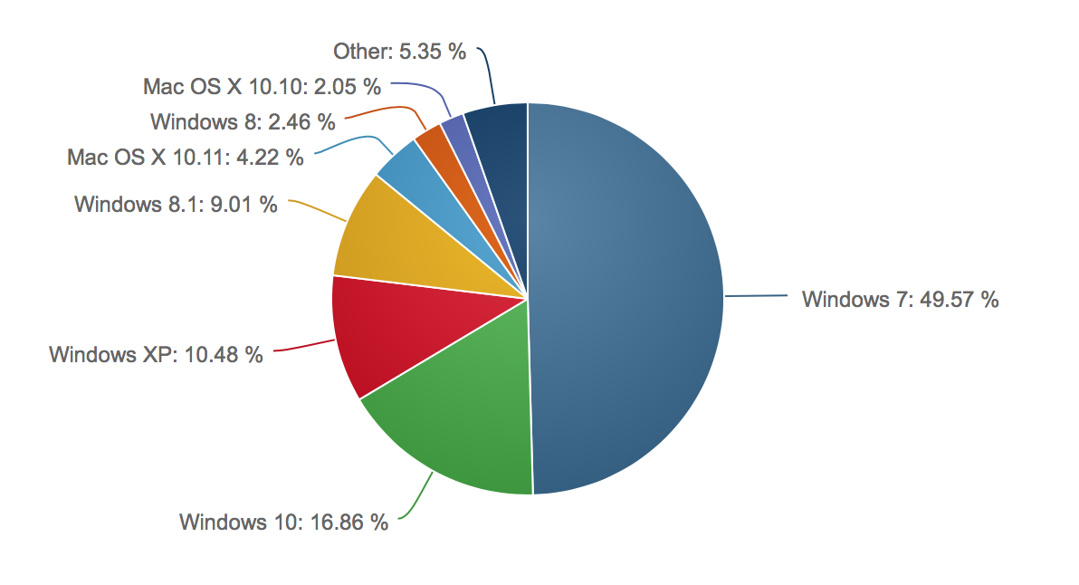
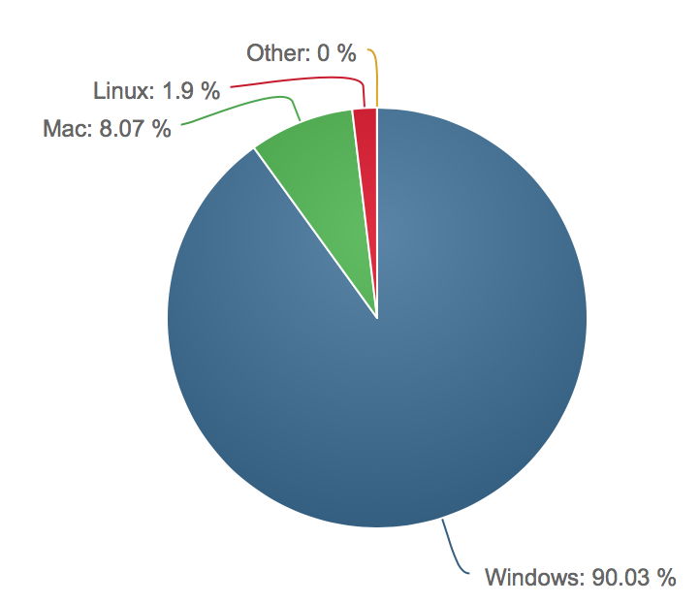
OS Desctop – Market Share
Kilde: http://marketshare.hitslink.com

Slide 6
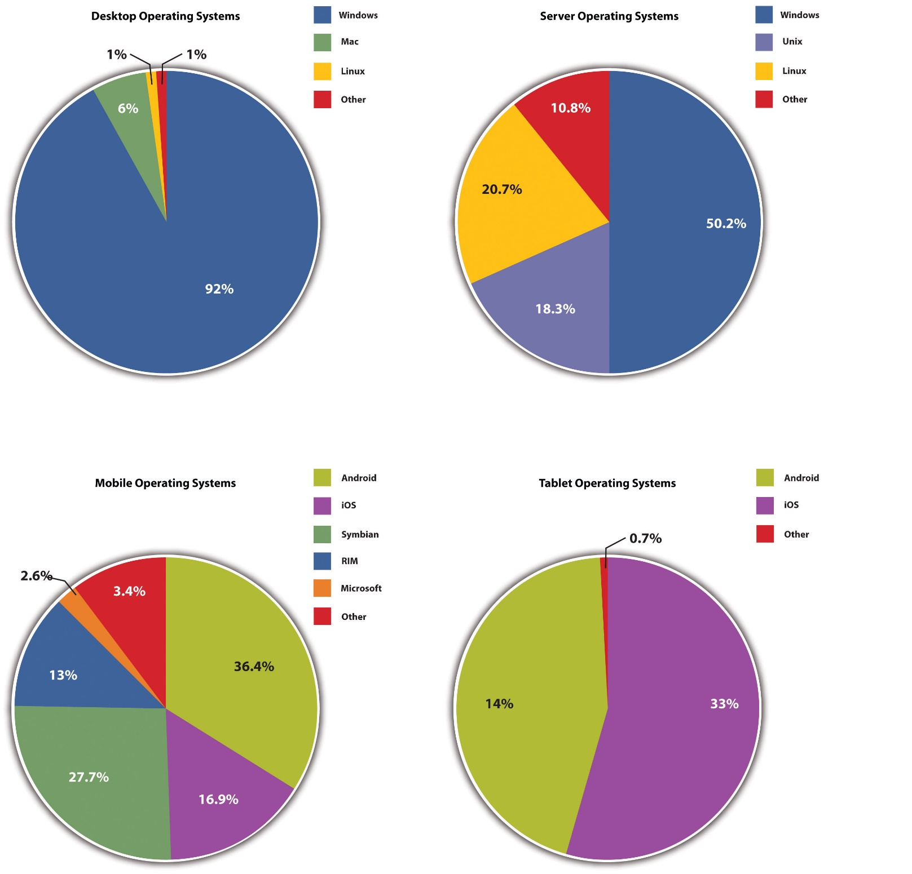

Slide 7
Types of operating systems
As computers have progressed and developed, so have the operating systems.
GUI - Short for Graphical User Interface, a GUI operating system contains graphics and icons and is commonly navigated by using a computer mouse.
Windows – OSX – Linux Ubuntu
Multi-user - A multi-user operating system allows for multiple users to use the same computer at the same time and different times.
Linux – Unix – Windows Server
Multiprocessing - An operating system capable of supporting and utilizing more than one computer processor
Linux – Unix – Windows 8 – 10
Multithreading - Operating systems that allow different parts of a software program to run concurrently.
Linux – Unix – Windows XP
Embedded - Operating systems designed to be compact, efficient at resource usage, and reliable, forsaking many functions that non-embedded computer operating systems provide.
Linux embedded version - OpenWrt

Slide 8
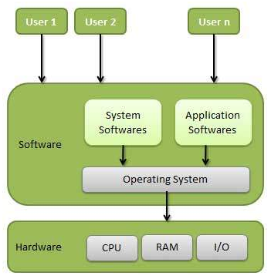
Computer System Structure
Computer system can be divided into four components
Hardware – provides basic computing resources
CPU, memory, I/O devices
Operating system
Controls and coordinates use of hardware among various applications and users
Application programs – define the ways in which the system resources are used to solve the computing problems of the users
Word processors, compilers, web browsers, database systems, video games
Users
People, machines, other computers

Slide 9
Memory Management
Memory management refers to management of Primary Memory or Main Memory. Main memory is a large array of words or bytes where each word or byte has its own address.
Main memory provides a fast storage that can be access directly by the CPU. So for a program to be executed, it must in the main memory. Operating System does the following activities for memory management.
Keeps tracks of primary memory i.e. what part of it are in use by whom, what part are not in use.
In multiprogramming, OS decides which process will get memory when and how much.
Allocates the memory when the process requests it to do so.
De-allocates the memory when the process no longer needs it or has been terminated.

Slide 10
Processor Management
In multiprogramming environment, OS decides which process gets the processor when and how much time.
This function is called process scheduling. Operating System does the following activities for processor management.
Keeps tracks of processor and status of process. Program responsible for this task is known as traffic controller.
Allocates the processor(CPU) to a process.
De-allocates processor when processor is no longer required.

Slide 11
Device Management
OS manages device communication via their respective drivers. Operating System does the following activities for device management.
Keeps tracks of all devices. Program responsible for this task is known as the I/O controller.
Decides which process gets the device when and for how much time.
Allocates the device in the efficient way.
De-allocates devices.

Slide 12
File Management
A file system is normally organized into directories for easy navigation and usage.
These directories may contain files and other directions. Operating System does the following activities for file management.
Keeps track of information, location, uses, status etc. The collective facilities are often known as file system.
Decides who gets the resources.
Allocates the resources.
De-allocates the resources.

Slide 13
Other Important Activities
Security By means of password and similar other techniques, preventing unauthorized access to programs and data.
Control over system performance Recording delays between request for a service and response from the system.
Job accounting Keeping track of time and resources used by various jobs and users.
Error detecting aids Production of dumps, traces, error messages and other debugging and error detecting aids.
Coordination between other softwares and users Coordination and assignment of compilers, interpreters, assemblers and other software to the various users of the computer systems.

Slide 14
Operating System Services
One set of operating-system services provides functions that are helpful to the user:
User interface - Almost all operating systems have a user interface (UI)
Varies between Command-Line (CLI), Graphics User Interface (GUI), Batch
Program execution - The system must be able to load a program into memory and to run that program, end execution, either normally or abnormally (indicating error)
I/O operations - A running program may require I/O, which may involve a file or an I/O device.
File-system manipulation - The file system is of particular interest. Obviously, programs need to read and write files and directories, create and delete them, search them, list file Information, permission management.

Slide 15
Operating System Services (Cont.)
One set of operating-system services provides functions that are helpful to the user (Cont):
Communications – Processes may exchange information, on the same computer or between computers over a network
Communications may be via shared memory or through message passing (packets moved by the OS)
Error detection – OS needs to be constantly aware of possible errors
May occur in the CPU and memory hardware, in I/O devices, in user program
For each type of error, OS should take the appropriate action to ensure correct and consistent computing
Debugging facilities can greatly enhance the user’s and programmer’s abilities to efficiently use the system

Slide 16
Operating System Services (Cont.)
Another set of OS functions exists for ensuring the efficient operation of the system itself via resource sharing
Resource allocation - When multiple users or multiple jobs running concurrently, resources must be allocated to each of them
Many types of resources - Some (such as CPU cycles,mainmemory, and file storage) may have special allocation code, others (such as I/O devices) may have general request and release code.
Accounting - To keep track of which users use how much and what kinds of computer resources
Protection and security - The owners of information stored in a multiuser or networked computer system may want to control use of that information, concurrent processes should not interfere with each other
Protection involves ensuring that all access to system resources is controlled
Security of the system from outsiders requires user authentication, extends to defending external I/O devices from invalid access attempts
If a system is to be protected and secure, precautions must be instituted throughout it. A chain is only as strong as its weakest link.

Slide 17
Linux - History
Linux was originally developed as a free operating system for personal computers based on the Intel x86 architecture, but has since been ported to more computer hardware platforms than any other operating system.
Thanks to its dominance on smartphones, Android, which is built on top of the Linux kernel, has the largest installed base of all general-purpose operating systems.
Linux, in its original form, is also the leading operating system on servers and other big iron systems such as mainframe computers and supercomputers, but is used on only around 1.5% of desktop computers with Linux-based Chrome OS taking about 5% of the overall and nearly 20% of the sub-$300 notebook sales.
Linux also runs on embedded systems, which are devices whose operating system is typically built into the firmware and is highly tailored to the system; this includes smartphones and tablet computers running Android and other Linux derivatives, TiVo and similar DVR devices, network routers, facility automation controls, televisions, video game consoles, and smartwatches.

Slide 18
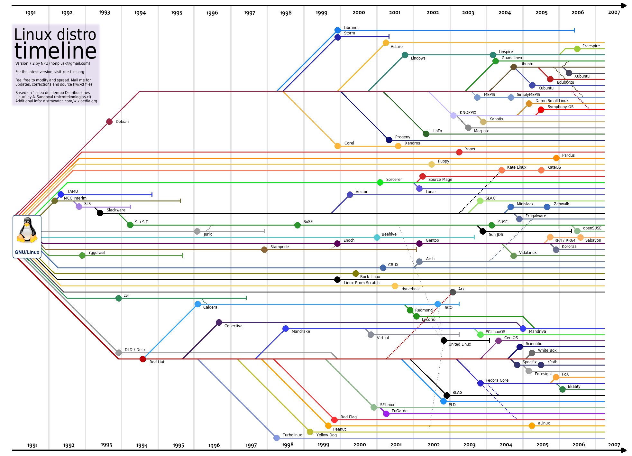

Slide 19
Digital Ocean

Slide 20
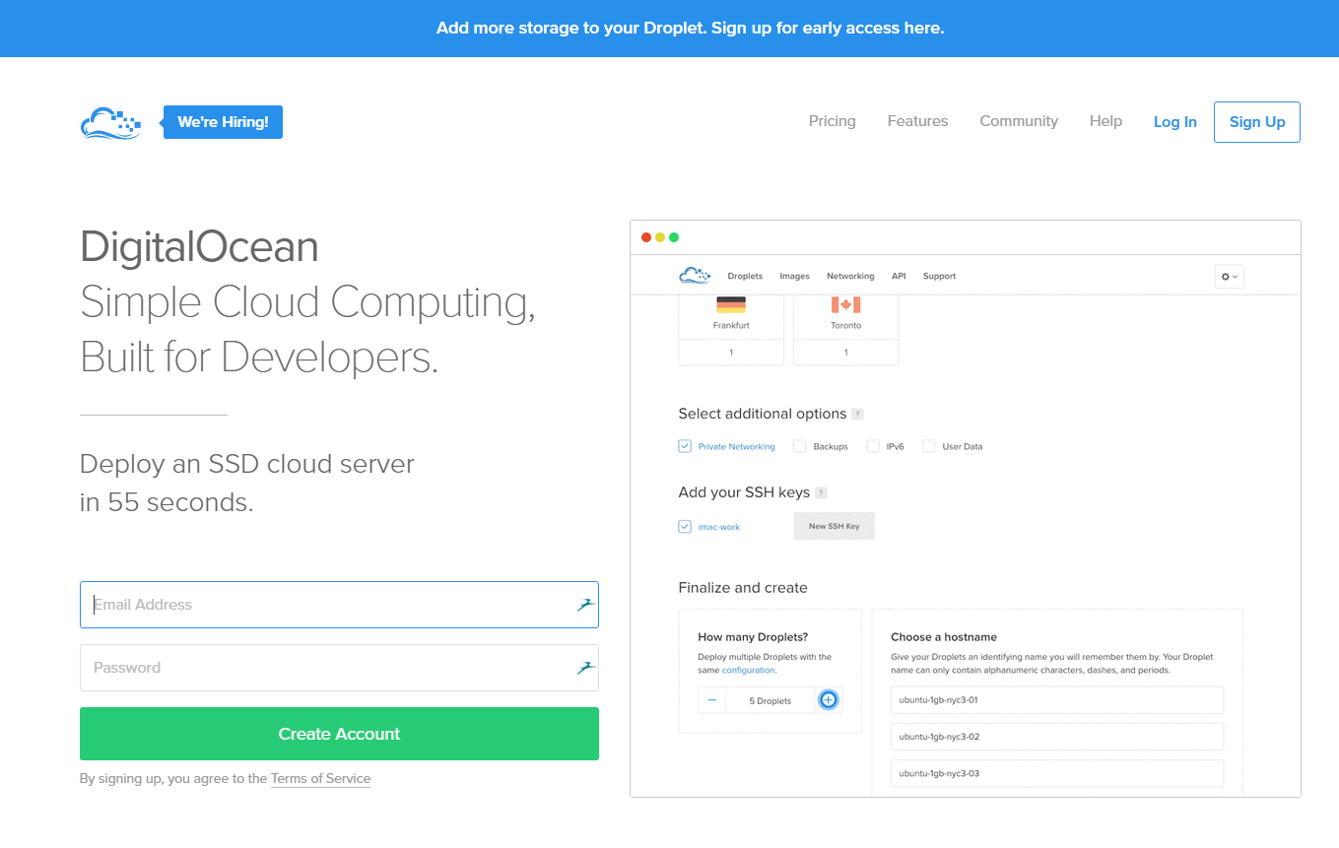
Digital Ocean
There are many provides which offer a Linux machine in the cloud.
For this set of exercises we recommend you as a group buy a 5$ (42 dkk incl moms) month access to an Ubuntu Linux machine at digital ocean.
You will only need to work which what is called a Unix shell, and we will set up a server as part of the next three days.
One machine can have several users logged in at the same time, and the cheapest version should do just fine.

Slide 21

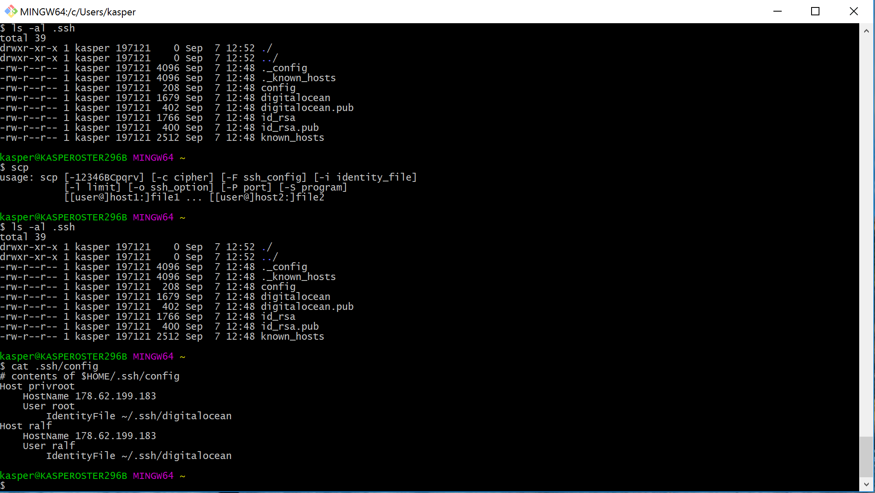
Connecting to a linux server
Connecting to a server using ssh is a two step procedure.
First you run the git-bash program to allow you to have a “shell” program to work on your own computer using a text-only interface
Second, you use the shell to connect to the digitalocean server – the command to do this is called ssh (secure shell).
Warning – it can be hard to tell at a glance if you are working on the server or on your own computer.

Slide 22
Git bash
We are going to use git from the prompt later on anyways, so we will use this tool to connect to our digitalocean linux from windows.
Mac users can connect using the build-in command prompt (named “Terminal”). Mac is a unix machine from the beginning.

Slide 23
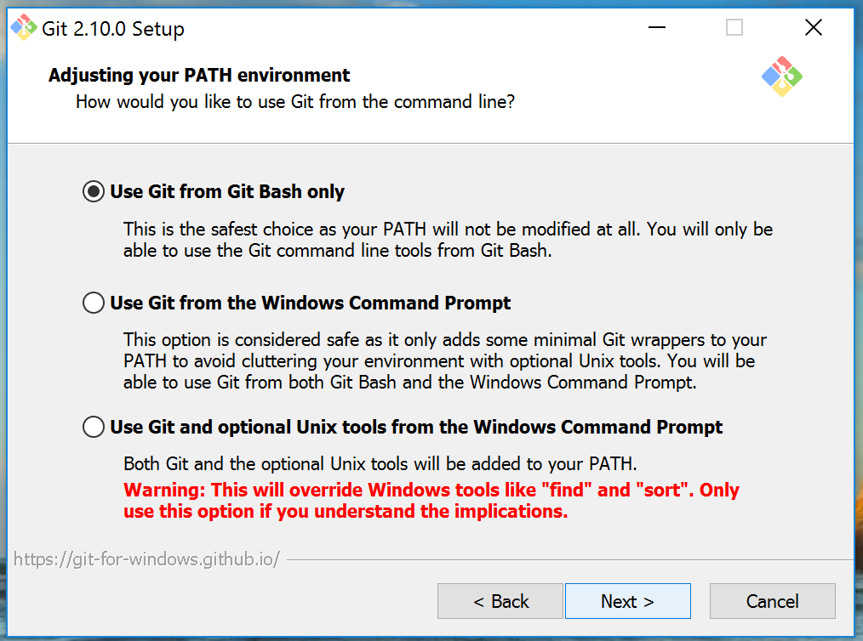
Installing GIT bash- Windows
Git (and in particular git-bash) can be installed from:
https://git-scm.com/download
The installer will at one point ask:
I believe the rest of the options can
left as they are.
Note: Mac has the necessary programs build in as the mac is a unix machine

Slide 24
Linux Commands

Slide 25
File Management
In Linux are three basic types of files
Ordinary Files − An ordinary file is a file on the system that contains data, text, or program instructions. In this tutorial, you look at working with ordinary files.
Directories − Directories store both special and ordinary files. For users familiar with Windows or Mac OS, UNIX directories are equivalent to folders.
Special Files − Some special files provide access to hardware such as hard drives, CD-ROM drives, modems, and Ethernet adapters. Other special files are similar to aliases or shortcuts and enable you to access a single file using different names.

Slide 26
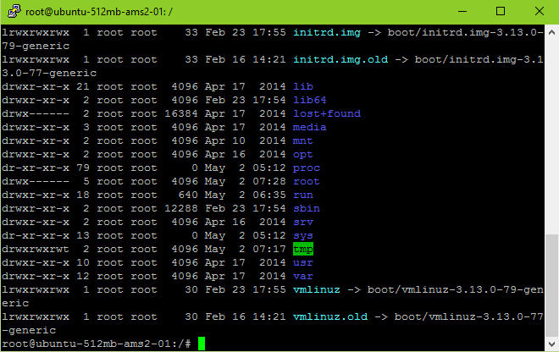
File Management – Listing files
To list the files and directories stored in the current directory. Use the following command – ls
Here is the information about all the listed columns
First Column: represents file type and permission given on the file. Below is the description of all type of files.
Second Column: represents the number of memory blocks taken by the file or directory.
Third Column: represents owner of the file. This is the Unix user who created this file.
Fourth Column: represents group of the owner. Every Unix user would have an associated group.
Fifth Column: represents file size in bytes.
Sixth Column: represents date and time when this file was created or modified last time.
Seventh Column: represents file or directory name.

Slide 27
File Management – Listing files
Prefix | Description
- | Regular file, such as an ASCII text file, binary executable, or hard link.
b | Block special file. Block input/output device file such as a physical hard drive.
c | Character special file. Raw input/output device file such as a physical hard drive
d | Directory file that contains a listing of other files and directories.
l | Symbolic link file. Links on any regular file.
p | Named pipe. A mechanism for interprocess communications
s | Socket used for interprocess communication.
a | All files – including hidden files

Slide 28
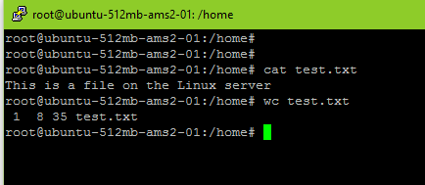
Display content of a file
You can use cat command to see the content of a file.
cat test.txt
Count the numbers of words in a file is very easy just use
wc test.txt
The command “less test.txt” shows the file one screen-full at a time.
head test.txt
show the first lines of the file

Slide 29
Directory Related Commands
cp – Copy of file - cp source_file destination_file
mv – Renaming - mv old_file new_file
rm – Delete – rm filename
cd – Change dir – cd~ (home dir) – cd- (last dir)
mkdir – Create directory - mkdir dirname
rmdir – Remove directory – rmdir dirname
pwd – print working directory - pwd
cd – Changing directory – cd dirname

Slide 30
Process Related Commands
ss Obtain a listing of processes and their id's. Including the option aux will show all processes.
top provides an ongoing look at processor activity in real time. It displays a listing of the most CPU-intensive tasks on the system, and can provide an interactive interface for manipulating processes.
netstat Print network connections, routing tables, interface statistics, masquerade connections, and multicast memberships
pstree shows running processes as a tree
kill send signal to a process
whoami Display information about the user

Slide 31
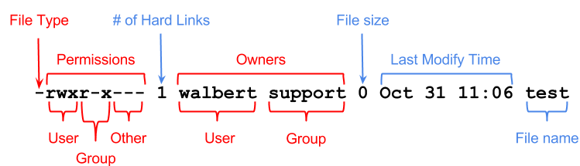
File permissions
If the command ls -l is given, a long list of file names is displayed. The first column in this list details the permissions applying to the file.
The chmod command changes the permission on a given file or directory.
chmod sets permissions in two ways.
Using symbols
Using octal values
Octal | Symbol | Permission
0 | --- | No Permissions
1 | --x | Execute
2 | -w- | Write
3 | -wx | Write and Execute
4 | r-- | Read
5 | r-x | Read and Execute
6 | rw- | Read and Write
7 | rwx | Read, Write, and Execute

Slide 32
File ownership
If the command ls -l is given, a long list of file names is displayed. The first column in this list details the permissions applying to the file.
The chown command changes the owners of a file on a given file or directory.
For obvious security reasons, the ownership of a file may only be altered by a super-user. Similarly, only a member of a group can change a file's group ID to that group.
Octal | Symbol | Permission
0 | --- | No Permissions
1 | --x | Execute
2 | -w- | Write
3 | -wx | Write and Execute
4 | r-- | Read
5 | r-x | Read and Execute
6 | rw- | Read and Write
7 | rwx | Read, Write, and Execute

Slide 33
Subdirectories of the root directory
Directory | Content
/bin | Common programs, shared by the system, the system administrator and the users.
/boot | The startup files and the kernel, vmlinuz. In some recent distributions also grub data. Grub is the GRand Unified Boot loader and is an attempt to get rid of the many different boot-loaders we know today.
/dev | Contains references to all the CPU peripheral hardware, which are represented as files with special properties.
/etc | Most important system configuration files are in /etc, this directory contains data similar to those in the Control Panel in Windows
/home | Home directories of the common users.
/initrd | (on some distributions) Information for booting. Do not remove!
/lib | Library files, includes files for all kinds of programs needed by the system and the users.
/lost+found | Every partition has a lost+found in its upper directory. Files that were saved during failures are here.
/misc | For miscellaneous purposes.
/mnt | Standard mount point for external file systems, e.g. a CD-ROM or a digital camera.
/net | Standard mount point for entire remote file systems
/opt | Typically contains extra and third party software.
/proc | A virtual file system containing information about system resources. More information about the meaning of the files in proc is obtained by entering the command man proc in a terminal window. The file proc.txt discusses the virtual file system in detail.
/root | The administrative user's home directory. Mind the difference between /, the root directory and /root, the home directory of the root user.
/sbin | Programs for use by the system and the system administrator.
/tmp | Temporary space for use by the system, cleaned upon reboot, so don't use this for saving any work!
/usr | Programs, libraries, documentation etc. for all user-related programs.
/var | Storage for all variable files and temporary files created by users, such as log files, the mail queue, the print spooler area, space for temporary storage of files downloaded from the Internet, or to keep an image of a CD before burning it.

Slide 34
Nano Editor

Slide 35
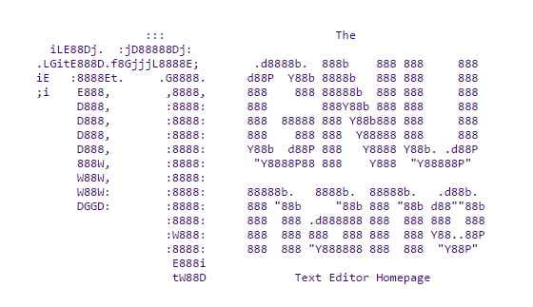
Nano Editor
nano is a text editor for Unix-like computing systems or operating environments using a command line interface.
It emulates the Pico text editor, part of the Pine email client, and also provides additional functionality.
In contrast to Pico, nano is licensed under the GNU General Public License (GPL).
Released as free software by Chris Allegretta in 1999, nano became part of the GNU Project in 2001.
www.nano-editor.org

